Slide 1
Arguing about the advantages and disadvantages of the roman army leaving Britain

Slide 2
After 400 years the romans had to leave Britain and go back to Rome
Why do you think they had to leave?

Slide 3
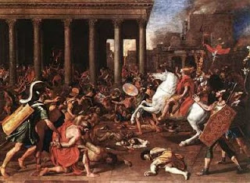
After 400 years in Britain, the Roman army had to leave and go back to Rome
Groups of warriors called the vandals were attacking Rome and every soldier was needed

Slide 4
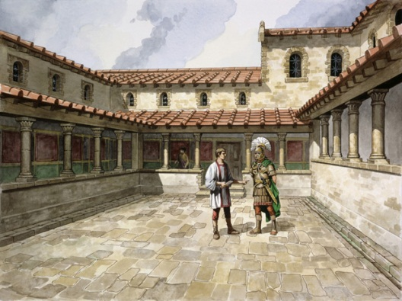
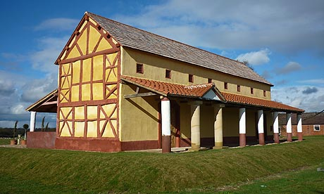
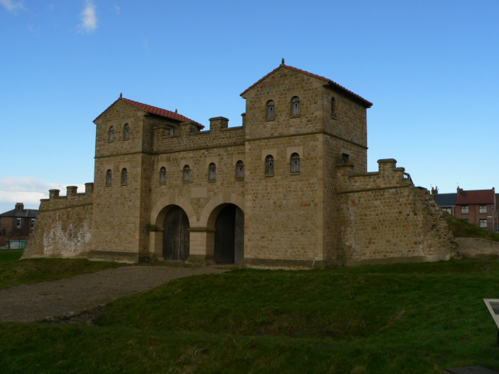
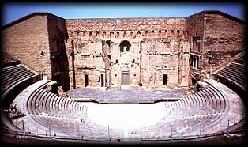
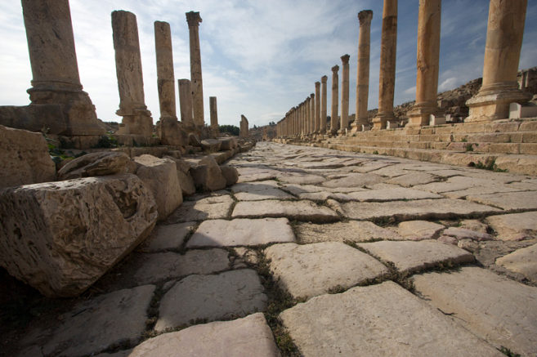
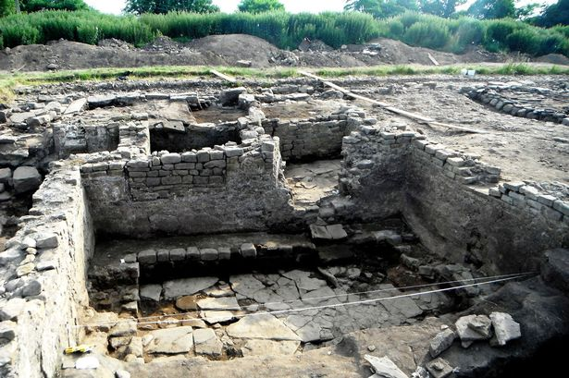
The Romans built many beautiful buildings in Britain
When they left, many of these buildings became ruins.

Slide 5
This is what Celts thought when the Romans left
Copy and Cut the cards out
The beautiful homes nearby are becoming ruins.
Its harder to pull our carts along the roads as they need repairing.
We don’t have to pay the romans taxes anymore.
We can’t protect our homes and land from invaders
Many people from other countries like France, Sweden and Ireland are settling in Britain.
The romans have left us empty homes that we can move into
There are a lot more things to buy because people are bringing them from other countries
The Romans never taught us how to rule ourselves. Our new rulers are very bad.
People are leaving the towns. The buildings are falling down
We have no coins to pay for things any more

Slide 6
Sort the cards out and place them on the right line.
Arguments for
Arguments against
1.
2.
3.
4.
5.
1.
2.
3.
4.
5.
Why it was good that the romans left Britain
Why it was bad that the romans left Britain

Slide 7
Arguments for
Put the cards on each line in order of the most important to the least important
Arguments against
1.
2.
3.
4.
5.
1.
2.
3.
4.
5.
Why it was good that the romans left Britain
Why it was bad that the romans left Britain

Slide 8
The language of explaining
 |  | reason |  | explanation
The best/ worst thing about the romans leaving was |  | e.g when invaders came |  | Celts couldn’t protect their homes and land
It was also good/ bad |  | e.g when they left their homes | therefore
Another reason is that | because | e.g there were no more coins | so
A fourth reason is |  | e.g the roads weren’t repaired
Finally |  | e.g
Example sentence : The worst thing about the romans leaving was that the Celts couldn’t protect their homes because ...................................................

Slide 9
Arguing
I think the best/ worst thing about the romans leaving was .................................because...........................................................
I think the second best/ worst thing about the romans leaving was...........................because....................................................
I think the third best/ worst thing about the romans leaving was..........................because...........................................................
I think the fourth best/ worst thing about the romans leaving was.........................because..........................................................
I think the fifth best/ worst thing about the romans leaving was ............................because..........................................................

Slide 10
Agreeing and disagreeing
Listen to what others say about fact number 1. Do you agree or disagree? Why?
I agree with number 1 as I also think..................................... I disagree with number 1 because I think that.........................
I agree with number 2 as I also think..................................... I disagree with number 2 because I think that.........................
I agree with number 3 as I also think..................................... I disagree with number 3 because I think that.........................
I agree with number 4 as I also think..................................... I disagree with number 4 because I think that.........................
I agree with number 5 as I also think..................................... I disagree with number 5 because I think that.........................

Slide 11
Framework for writing your argument
I think it was a good / bad thing that Romans left Britain to go back to Rome to defend their city.
The first good/ bad thing was that...........................................................................
because....................................................................................................................
The second good/ bad thing was that......................................................................
because......................................................................................................................
The third.....................................................................................................................
....................................................................................................................................
The fourth..................................................................................................................
...................................................................................................................................
The fifth......................................................................................................................
....................................................................................................................................

